Slide 1
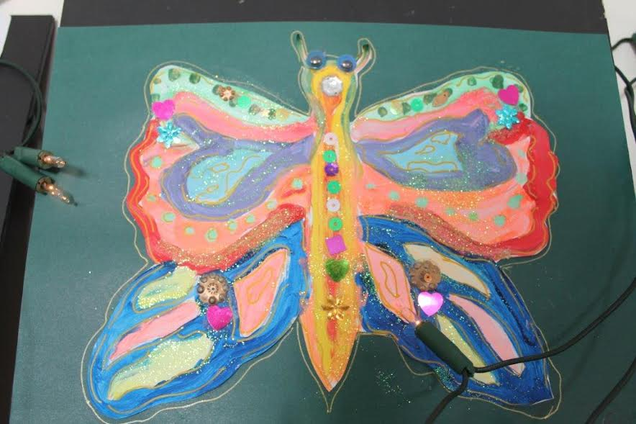
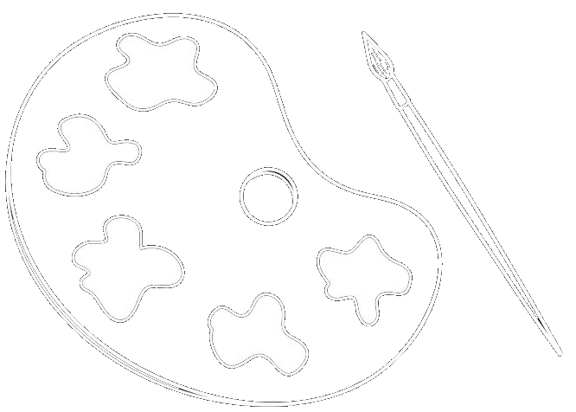
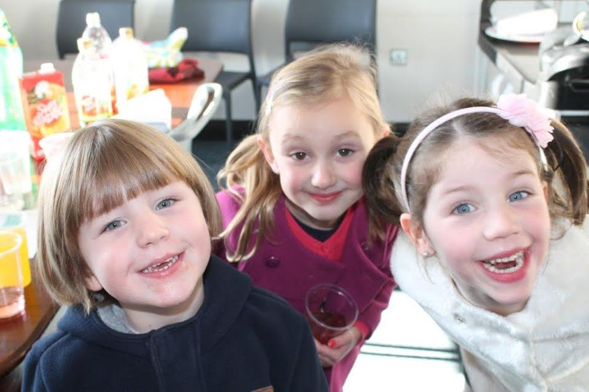
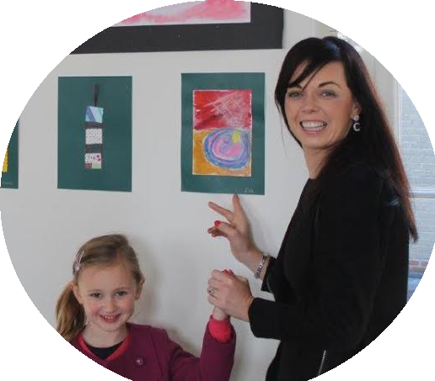
Ger Buckley
Art Classes!

Slide 2
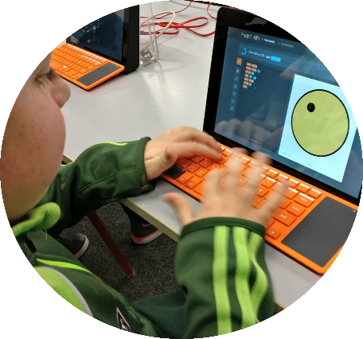

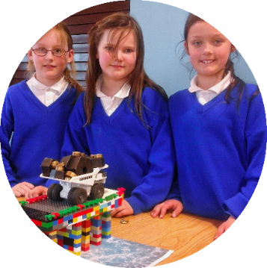
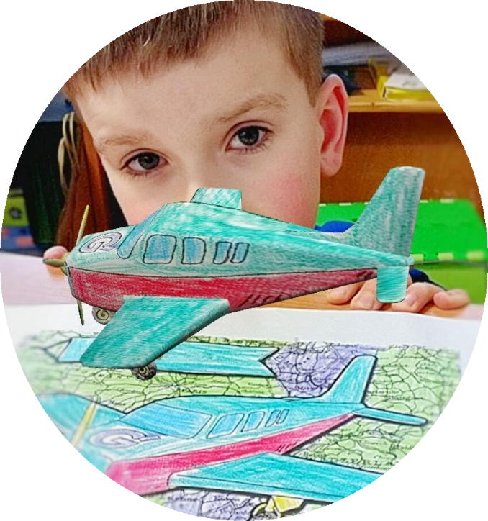
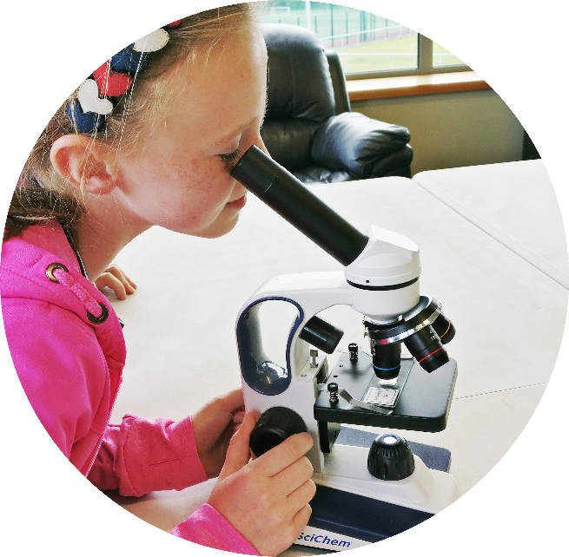
Summer Camp
ROOM 14

Slide 3
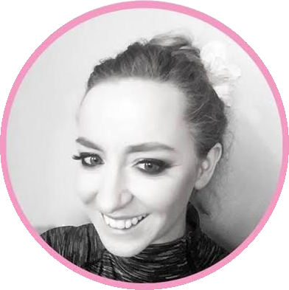

Movement for Moms!
ROOM 8/9
TUESDAYS &
THURSDAYS
Liz Cronin’s

Slide 4
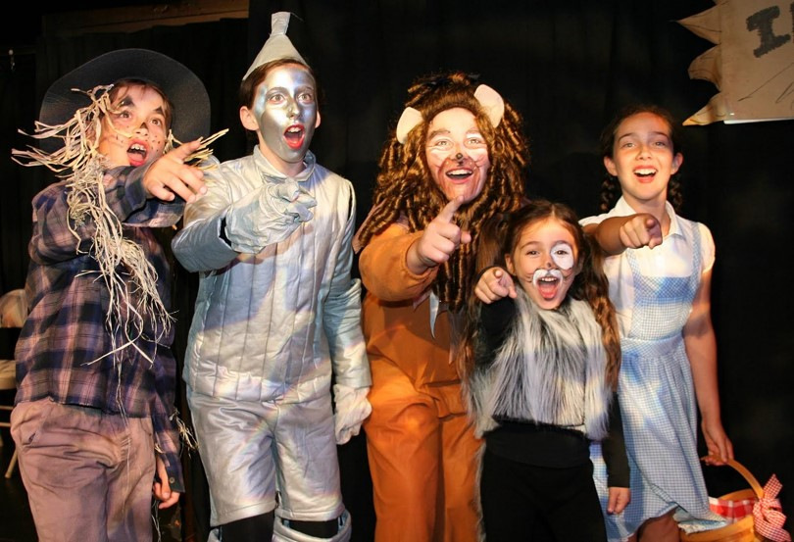

SHINING DRAMA

Slide 5
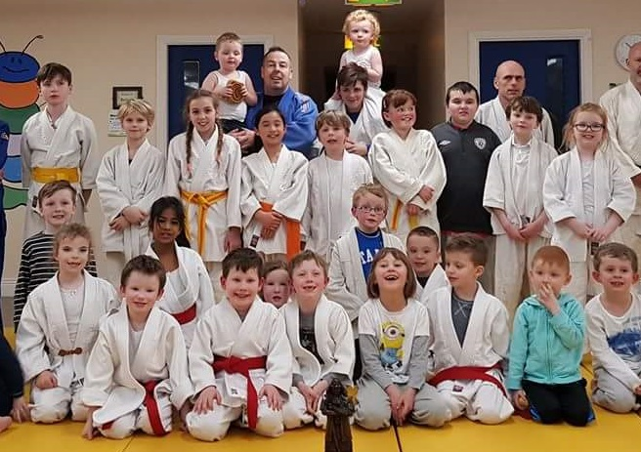
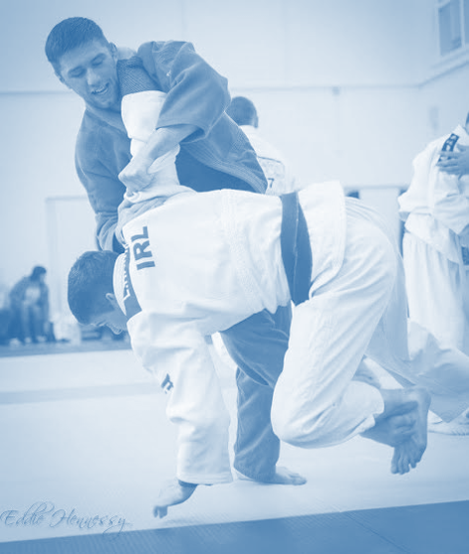

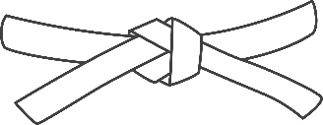
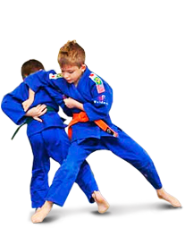
ROOM 14
TUESDAYS
THRUSDAYS
Cork
JUDO
Club

Slide 6
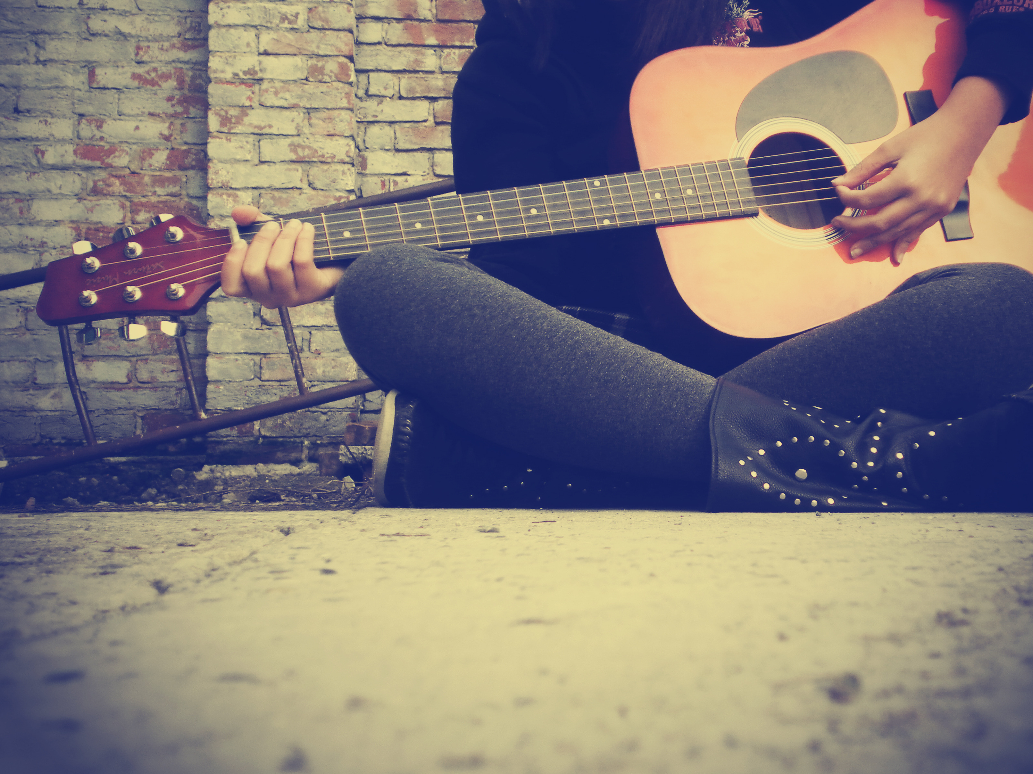
Vincent O’ Rourke
Guitar Lessons

Slide 7
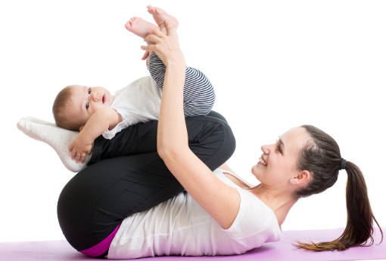
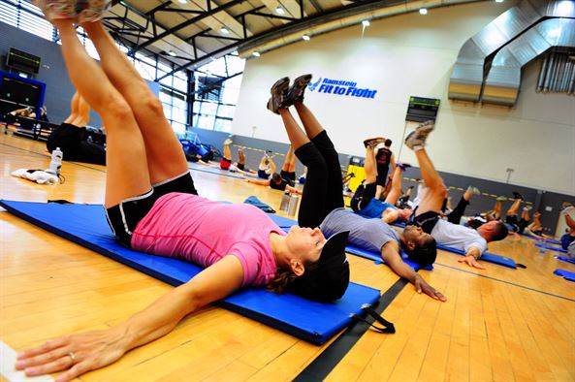
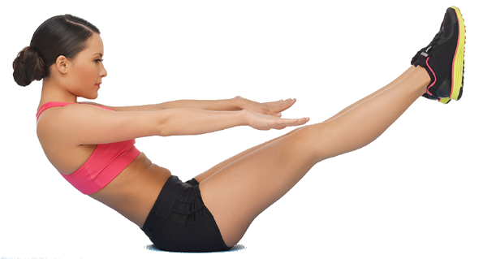
ROOM 8/9
TUESDAYS &
THURSDAYS
Carmel O Regan
PILATES, CIRCUITS, HIIT CLASSES

Slide 8

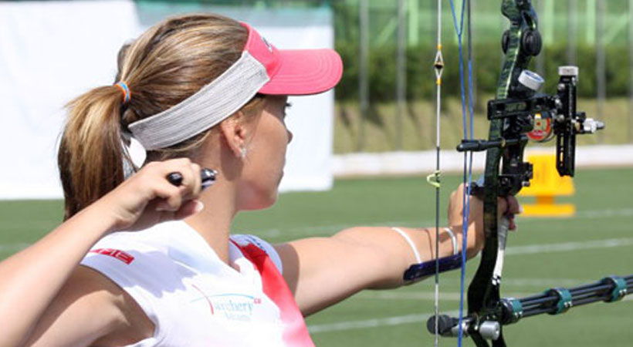

Cobh Archery Club
REBEL COUNTY
SUNDAYS
MAIN HALL
11AM – 2PM

Slide 9
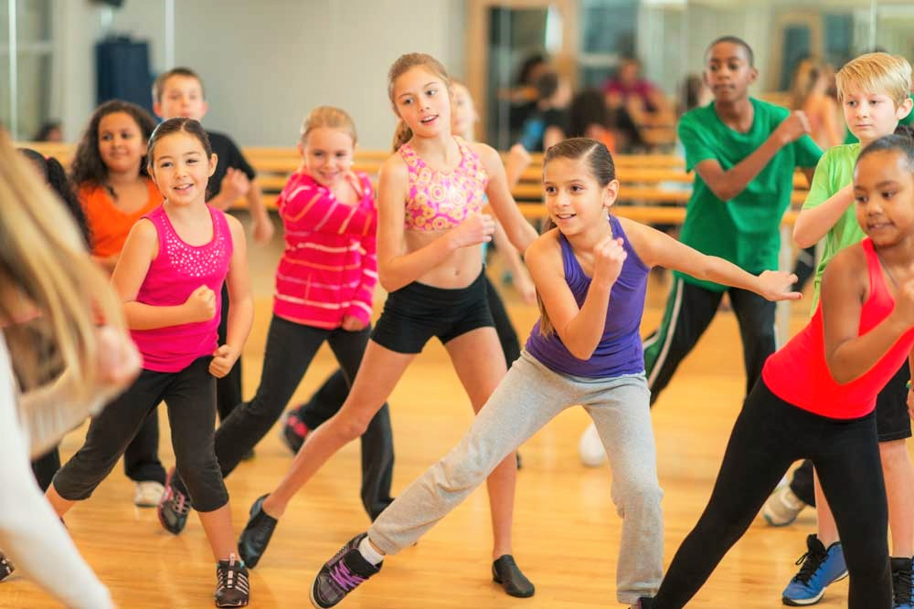
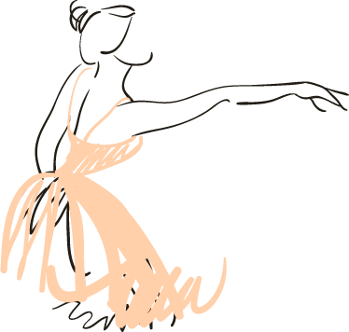

Sarah Callanan
School of Dance

Slide 10

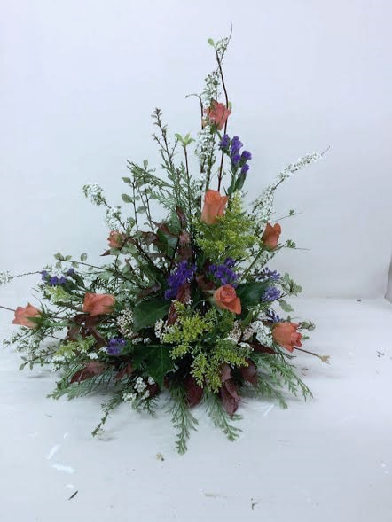
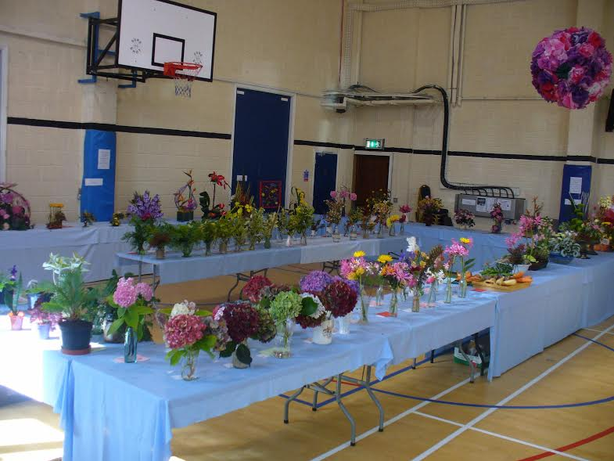

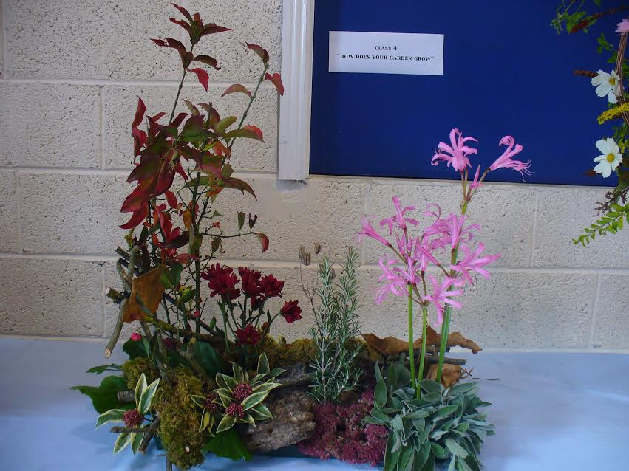
Cobh
Flower Club

Slide 11
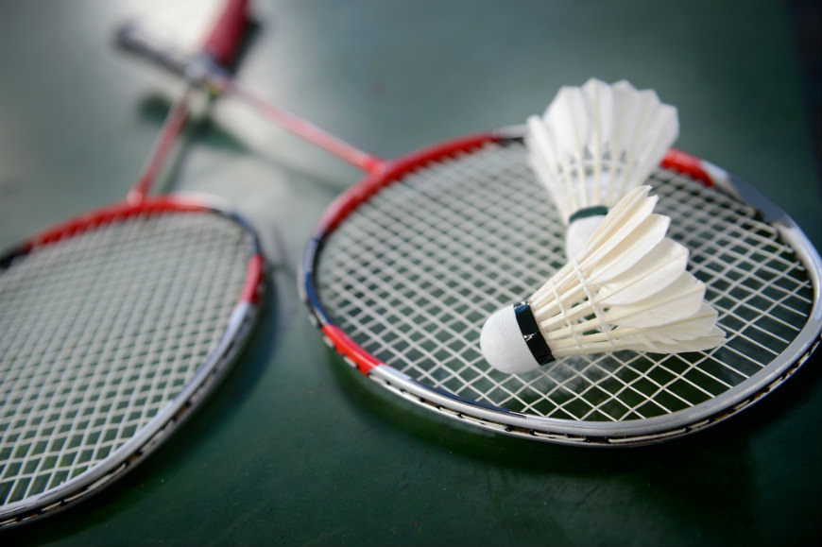

MAIN HALL
TUESDAY
7:30PM – 9PM
Cobh
Badminton Club

Slide 12
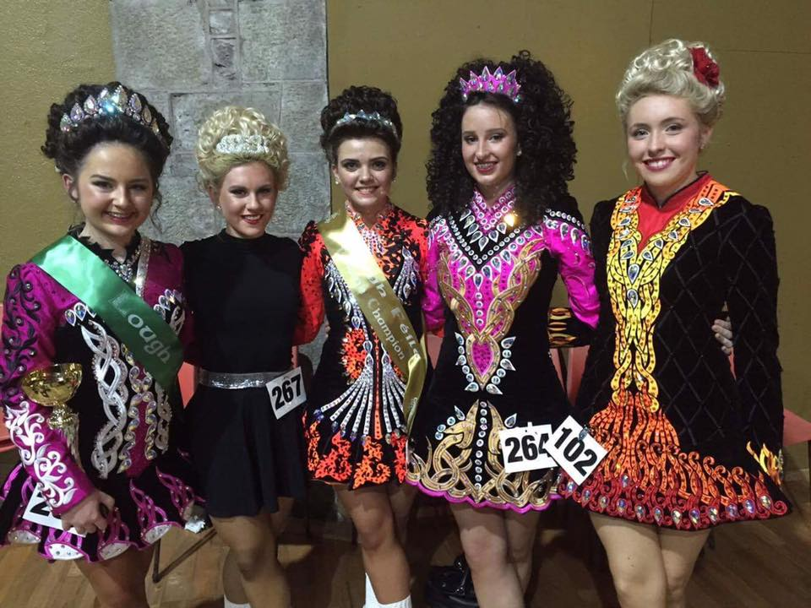
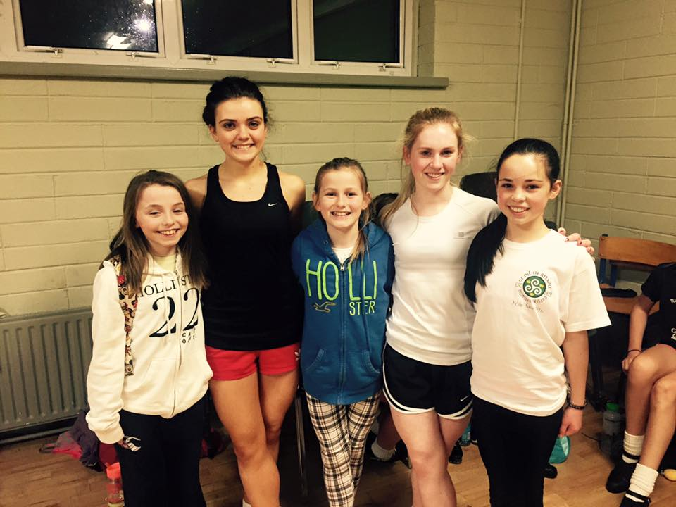

ROOM 14
WEDNESDAYS
4:30 – 7PM

Slide 13



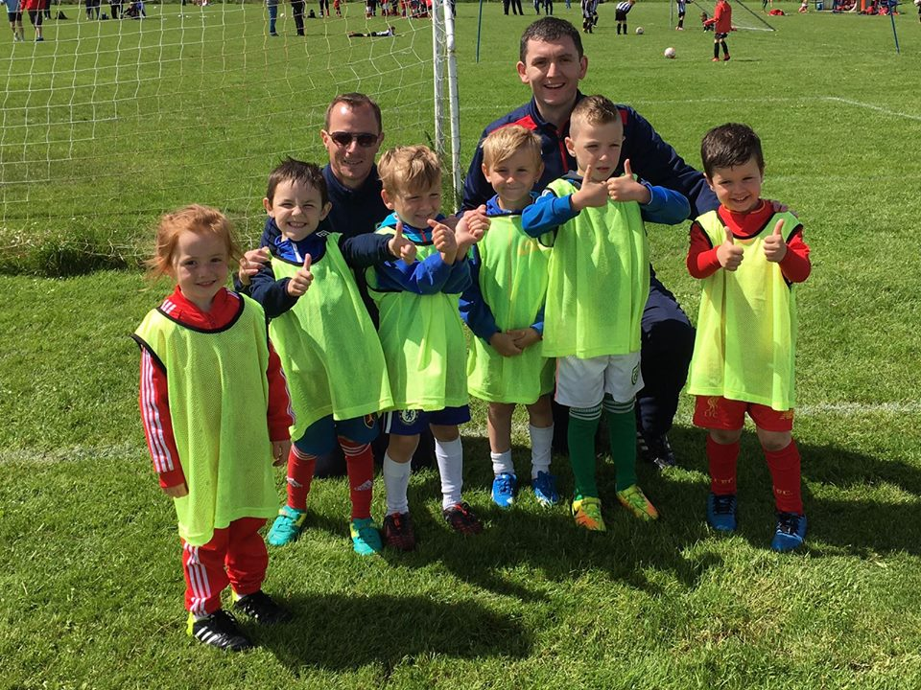

MAIN HALL
THRUSDAYS
7PM – 9PM

Slide 14
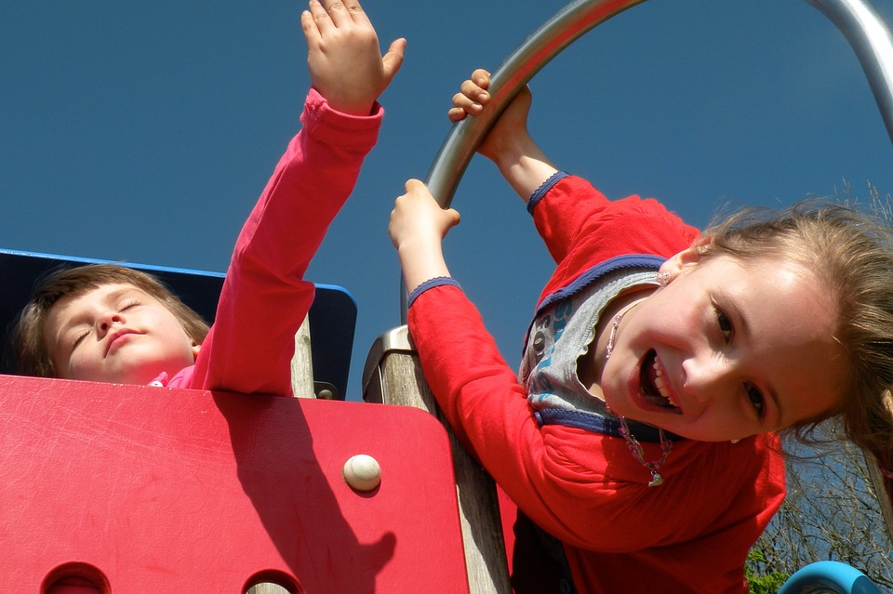

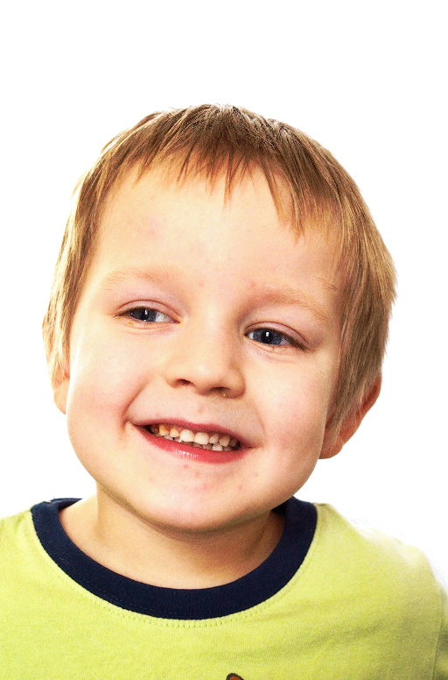

Cobh Youth Services
Developed to empower children and young people to reach their full potential
TUESDAYS - MAIN HALL
Place your screenshot here

Slide 15
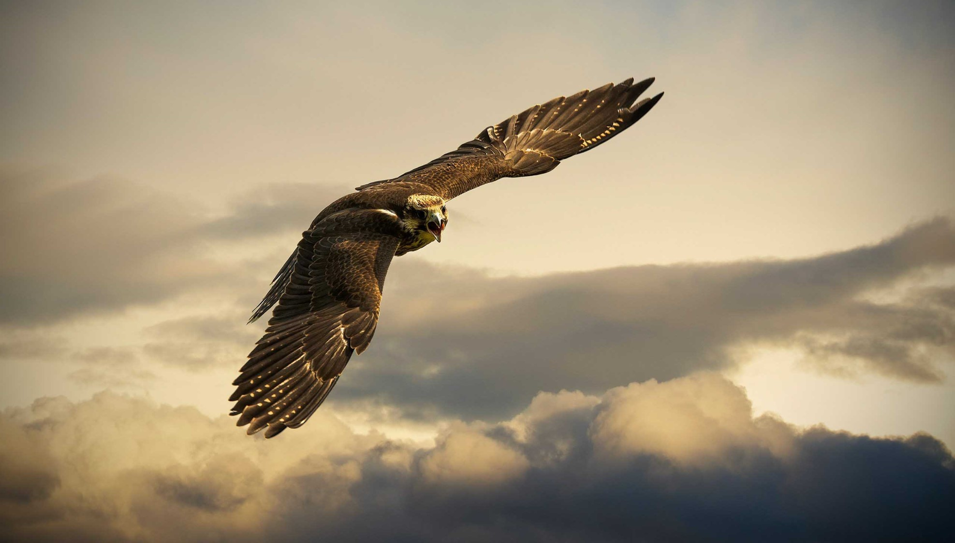

COBH BIRD CLUB
EVERY 2ND THURSDAY
ROOM 7
8:30PM – 9:30PM

Slide 16
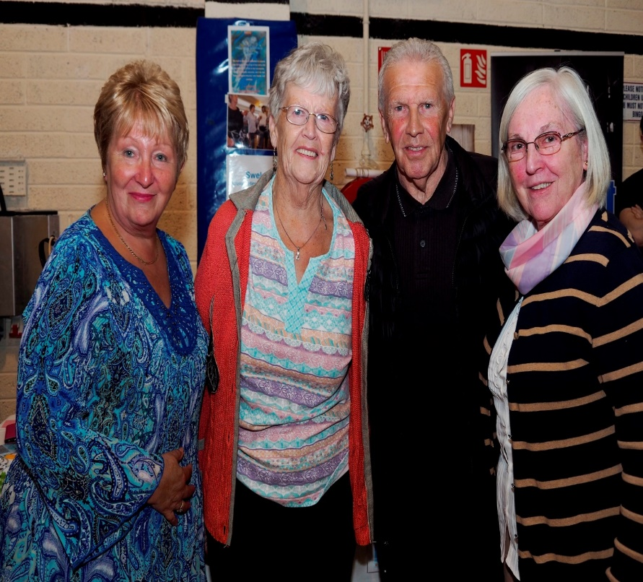
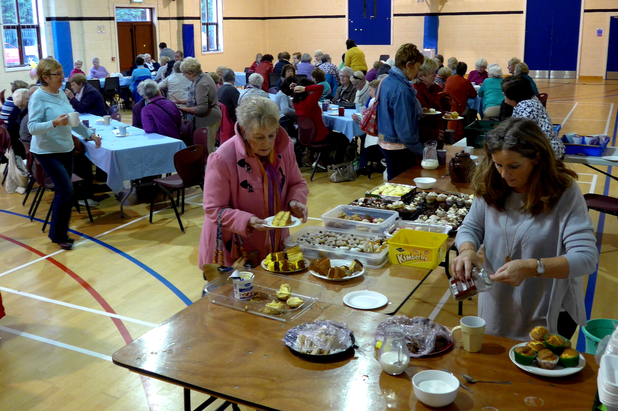
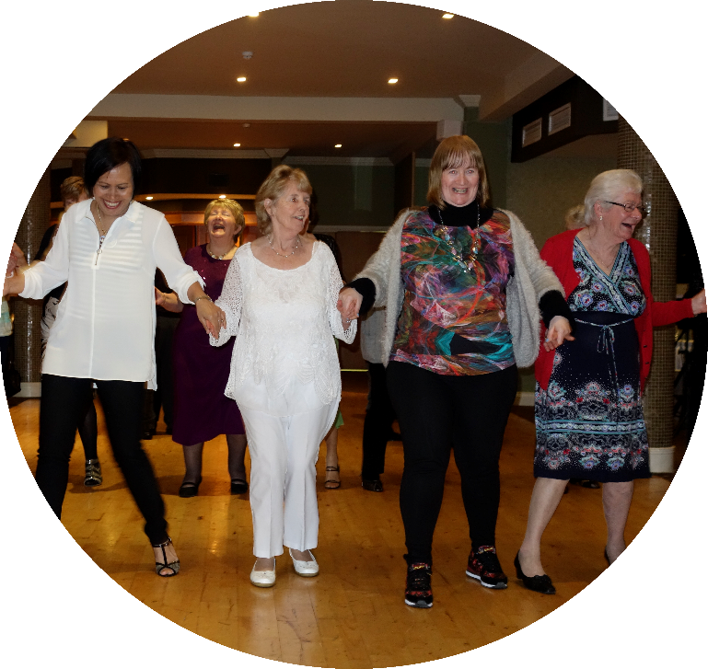
MAIN HALL
MONDAYS
10AM – 12AM
SWELS

Slide 17
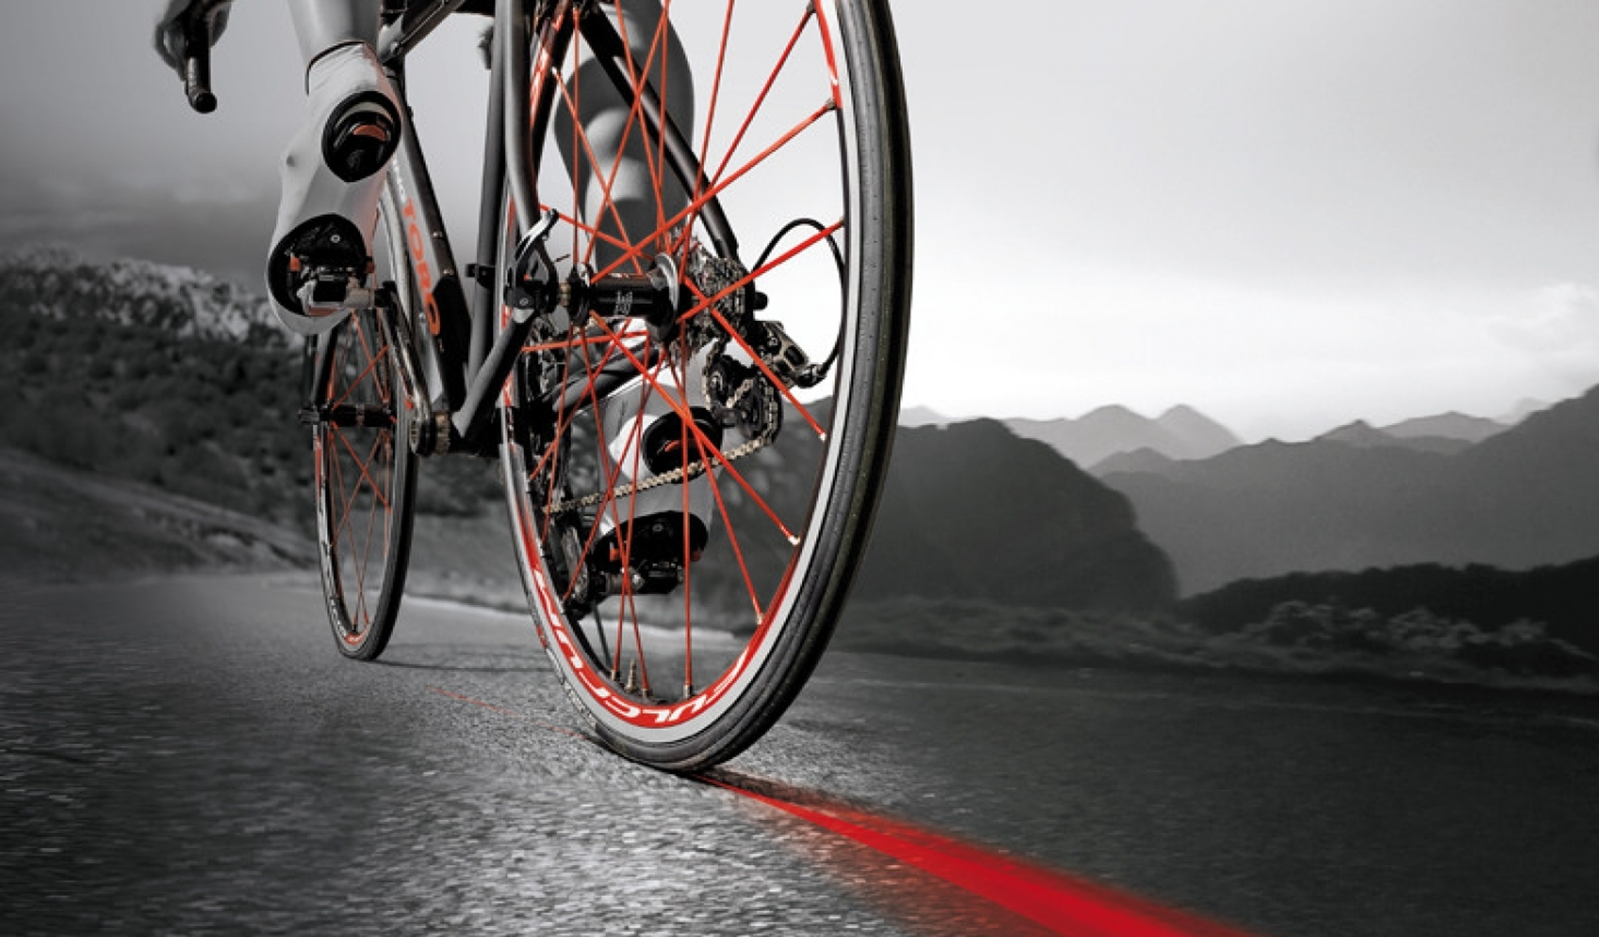


Slide 18
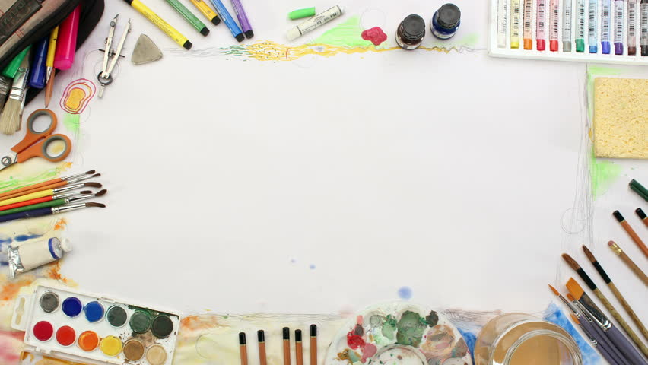
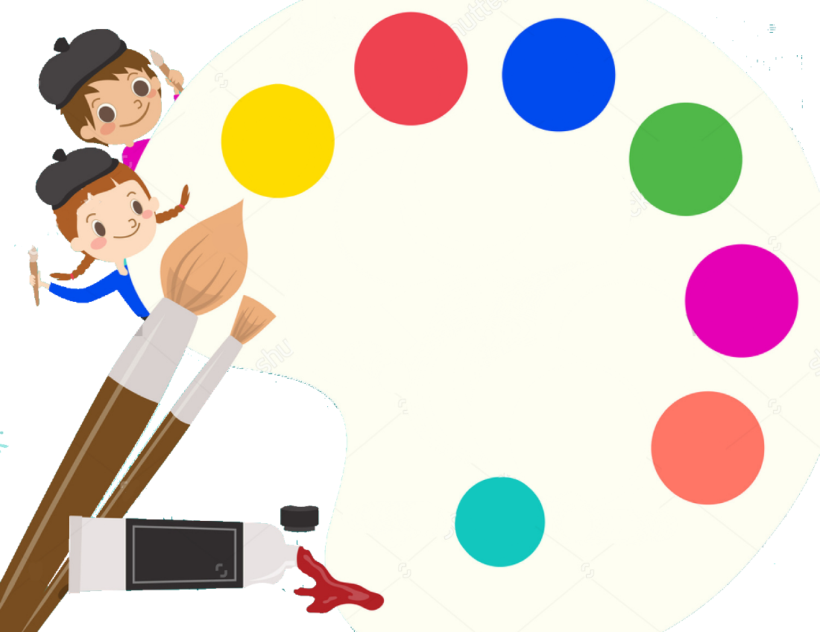
Childrens
Art & Craft
Workshops

Slide 19

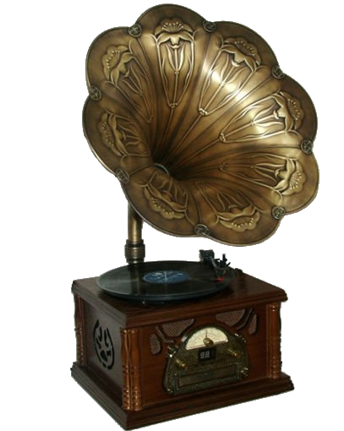
Cobh Gramaphone
Society

Slide 20
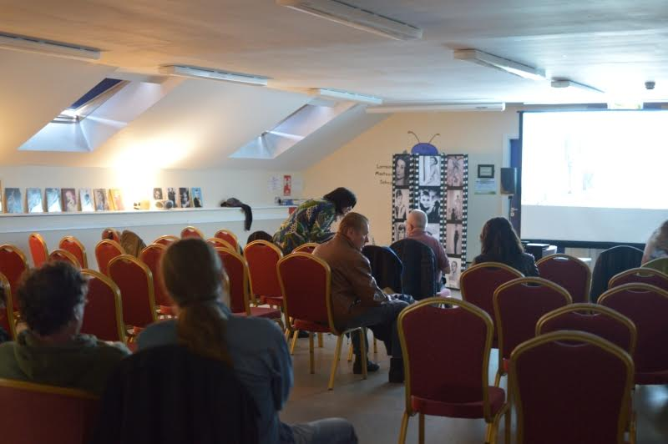



East Cork
MONDAYS
ROOM 14

Slide 21
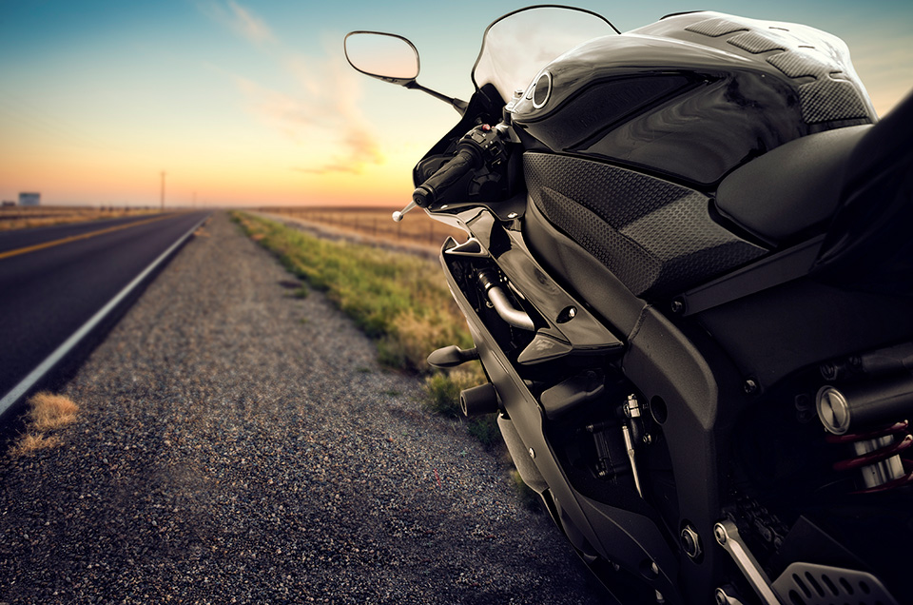
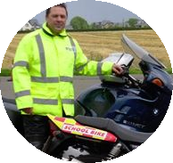
CORK MOTORCYCLE CLUB

Slide 22
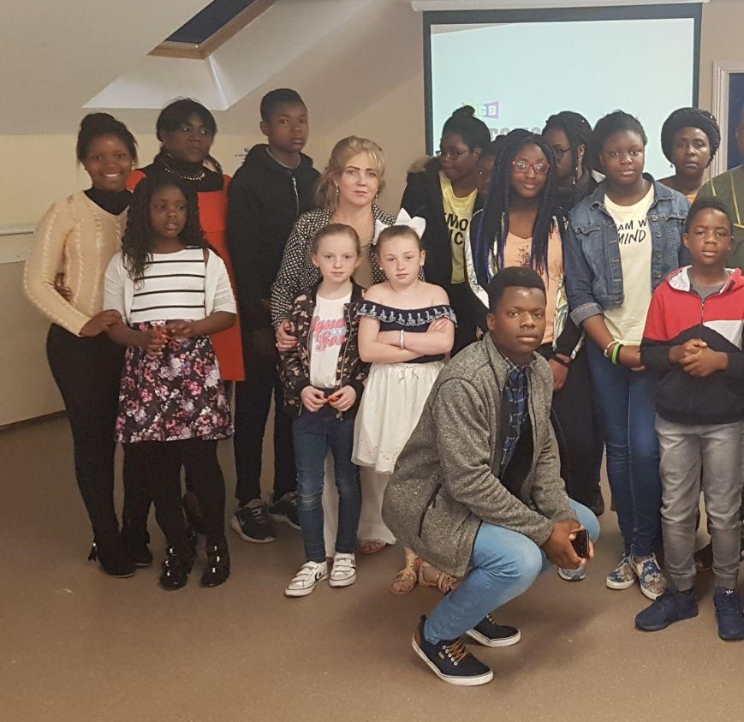
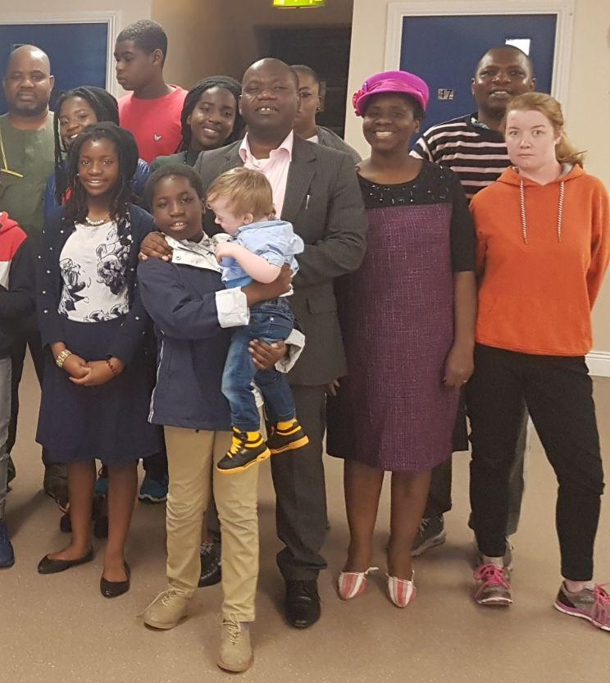


Slide 23
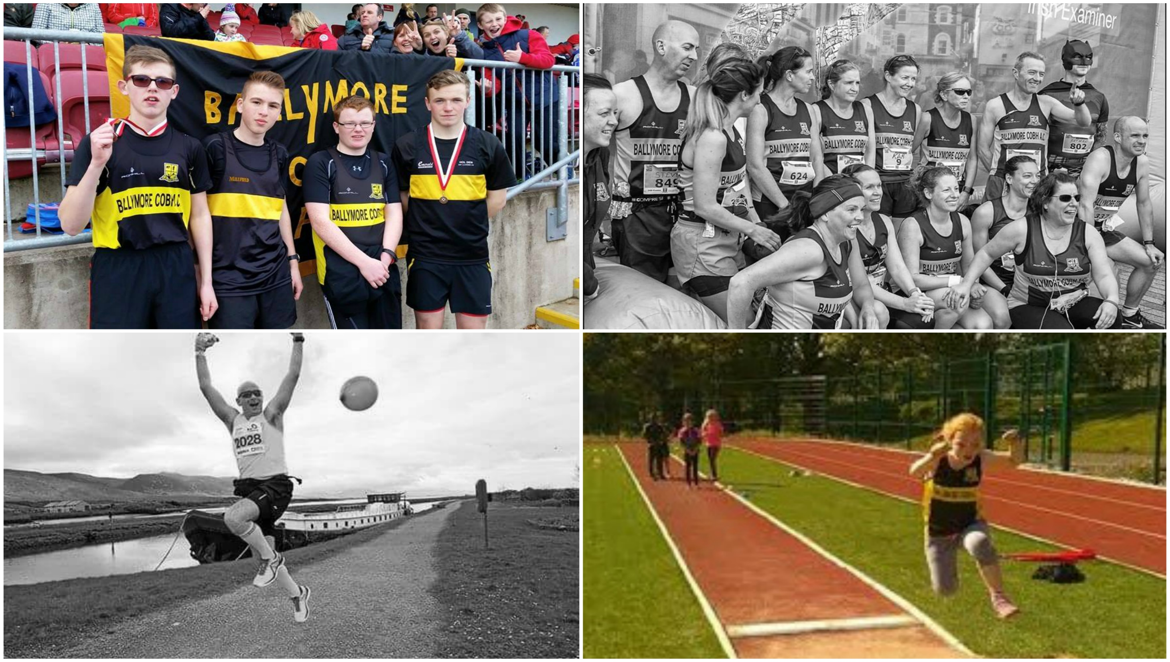

CORK MOTORCYCLE LESSONS

Slide 24
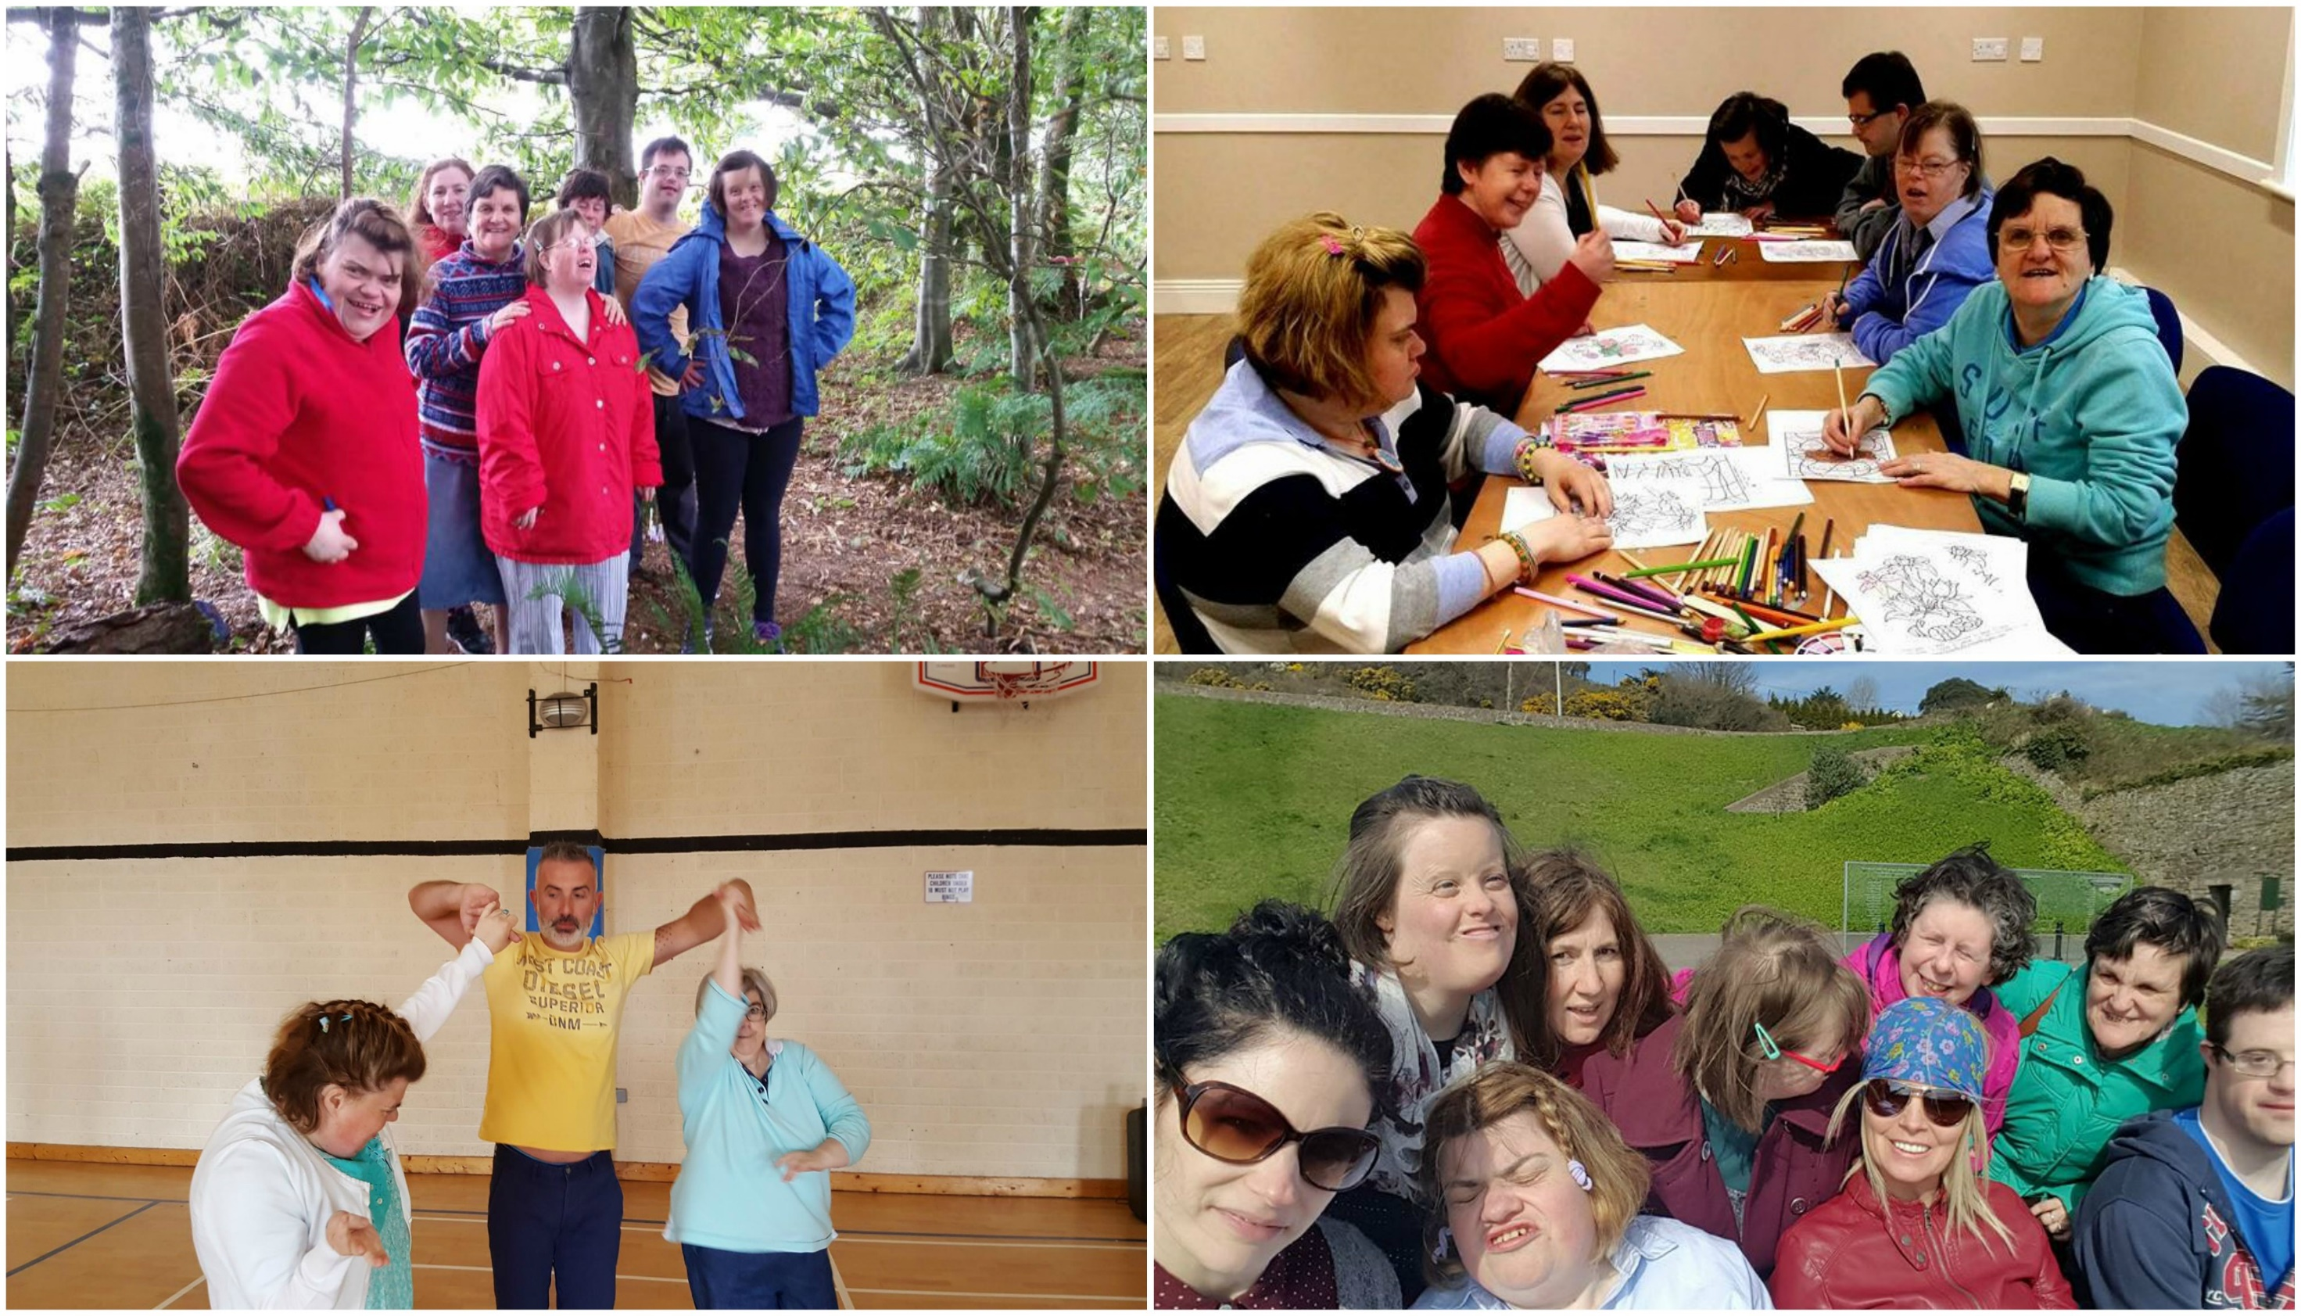


Slide 25
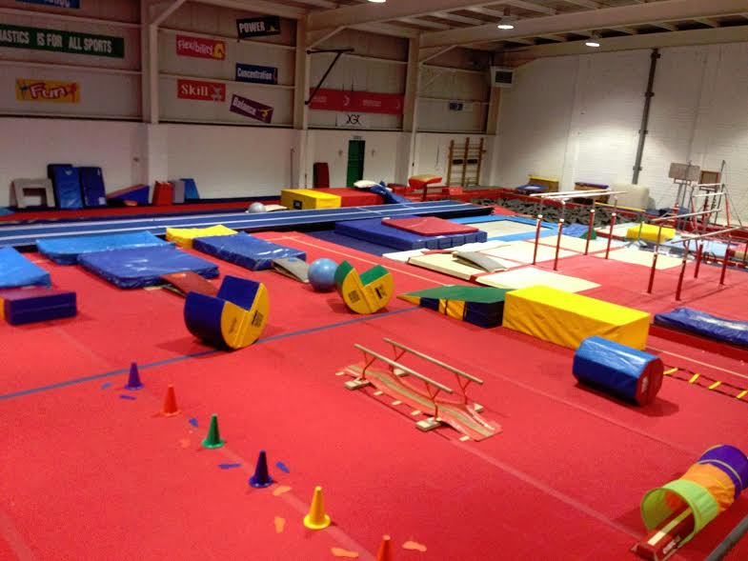

THURS 1:30PM – 7PM
SAT 1PM – 5PM

Slide 26
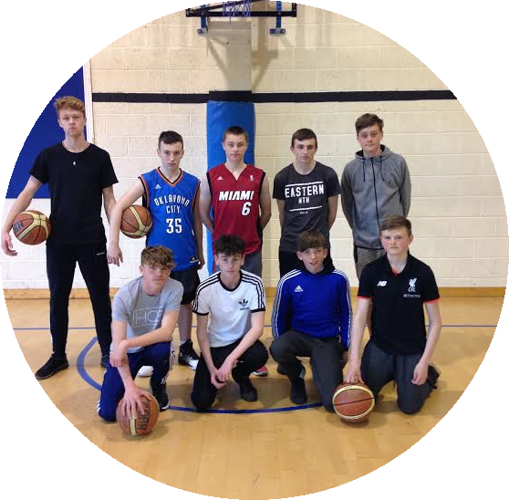
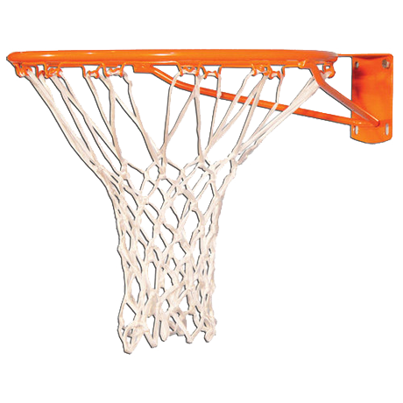

COBH
BASKETBALL
CLUB
BOYS & MENS
MON + WED

Slide 27
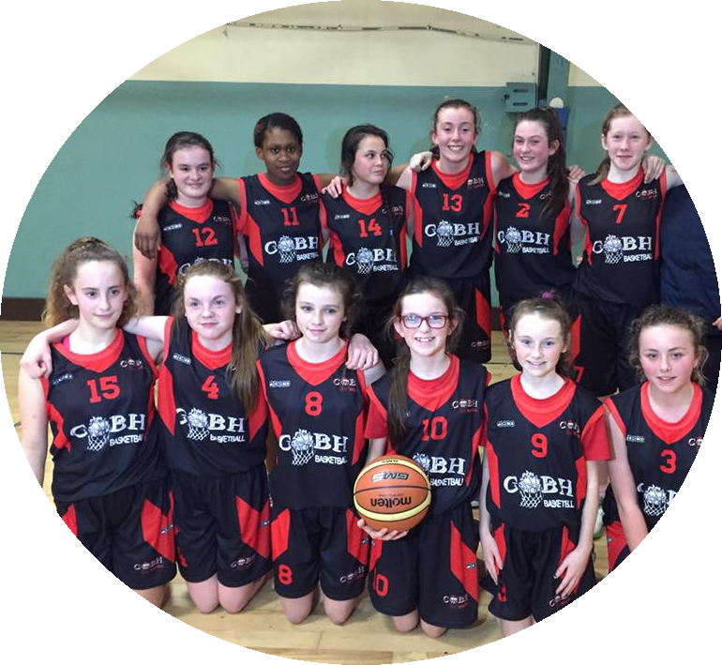
COBH
BASKETBALL
CLUB
GirLs
WED & SAT

Slide 28


MONTHLY
MEETINGS
CONTACT RECEPTION

Slide 29
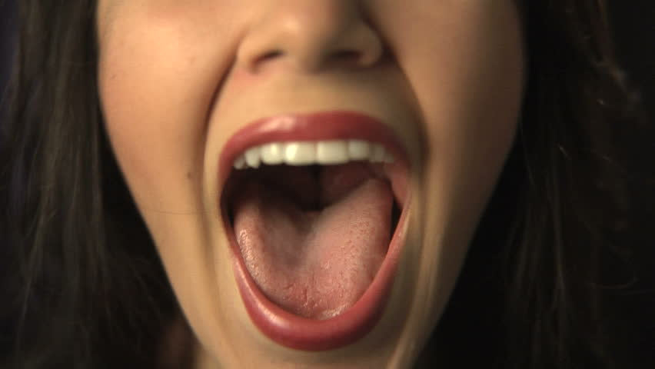

[WORKSHOPS]
CONTACT RECEPTION

Slide 30

ANNUAL CAT SHOW
SEPTEMBER

